Slide 1


Nakul Pant
20-Dec-2023

Slide 2

Outline
Executive Summary
Introduction
Methodology
Results
Conclusion
Appendix

Slide 3
Executive Summary
Summary of methodologies:
Data Collection : Working with SPACEX data generated from REST API.
Web Scrapping : Using python Beautiful Soup.
Data Wrangling : Using panda and Numpy.
Exploratory Data Analysis : With the help of Matplotlib, Seaborne and Folium and Dashboard.
Model Development : With the help of Si-kit.

Slide 4
Outline
Summary of all results:
Data Collection Result : Data gathered in proper format with column names.
Data Cleaning Result : Removing all the discrepancies in the data.
Exploratory Data Analysis Result : Visualization and dashboard and screenshots.
Model Development Result : Through cross validation and model score.
Cross Validation : Checking accuracy scores and hyper parameter tuning.

Slide 5
Introduction
Project background and context :
We will predict if the Falcon 9 first stage will land successfully. SpaceX advertises Falcon 9 rocket launches on its website, with a cost of 62 million dollars; other providers cost upward of 165 million dollars each, much of the savings is because SpaceX can reuse the first stage. Therefore if we can determine if the first stage will land, we can determine the cost of a launch. This information can be used if an alternate company wants to bid against SpaceX for a rocket launch.

Slide 6
Introduction
Problems you want to find answers:
Prediction Accuracy:
How accurately can the model predict the successful landing of the Falcon 9 first stage? What is the model's precision, recall, and overall accuracy?
Cost Analysis:
Once the model predicts the success of the landing, how does this information impact the overall cost of the rocket launch? What is the potential cost savings for launches where the first stage is expected to land successfully?
Bid Strategy:
Given the predicted landing outcome, how can an alternate company strategically bid against SpaceX for a rocket launch contract? What factors should be considered in developing a competitive bid?
Operational Insights:
Are there operational insights that can be derived from the data? For example, are there specific conditions or scenarios where the success rate is higher or lower?

Slide 7

Section 1 : Methodology

Slide 8
Methodology
Executive Summary
Data collection methodology:
The data was collected using SPACE X API and scraping SPACEX Wikipedia page.
Perform data wrangling:
Data was cleaned using python libraries like Numpy and Pandas.
Perform exploratory data analysis (EDA) using visualization and SQL.
Perform interactive visual analytics using Folium and Plotly Dash.
Perform predictive analysis using classification models.
Building ML pipeline: Preprocessing, Train Test Split, hyper parameter tuning , Data Modelling with Logistic Regression, SVM, Decision Tree Classifier and K nearest neighbor.

Slide 9
Data Collection
Following steps were involved in Data Collection:
• SpaceX API: –
Data was collected by sending a GET request to SpaceX API .
The data was decoded as json using .json() and turned into a Data Frame using json normalize().
All the discrepancies in the data were removed like Null values.
• Web-Scraping: –
Falcon 9 launch records were also collected by web-scraping from Wikipedia.
A HTTP GET request was sent to Falcon 9 launch HTML page.
The data was parsed and stored as a Data Frame using BeautifulSoup.
GIT HUB Link : https://github.com/Nakul-Pant-DS/IBM-Data-Science-Capstone-Project/blob/main/jupyter-labs-spacex-data-collection-api.ipynb

Slide 10
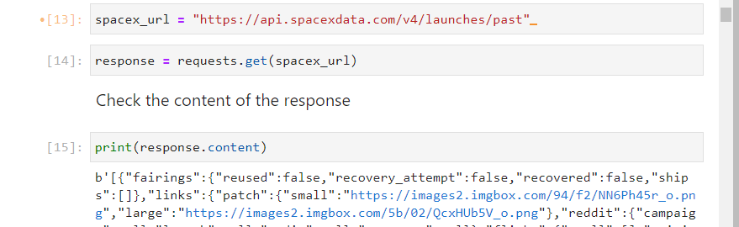
Data Collection – SpaceX API
Request to SPACEX API:
The code snippet shows how
a content is generated by
creating a SPACEX URL object
by requests.get and then
printing the response.
GIT Hub Link : https://github.com/Nakul-Pant-DS/IBM-Data-Science-Capstone-Project/blob/main/jupyter-labs-spacex-data-collection-api.ipynb

Slide 11
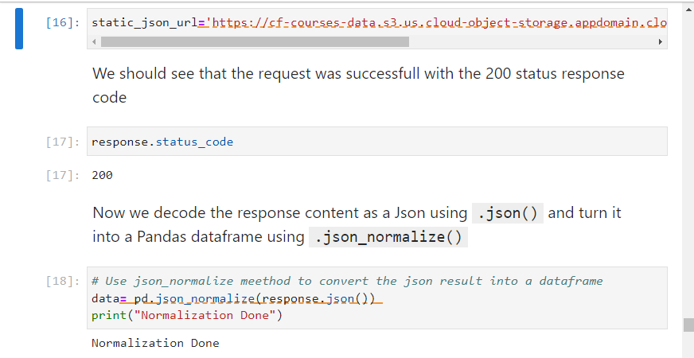
Data Collection – SpaceX API
Request and parse the SpaceX launch
data using the GET request

Slide 12
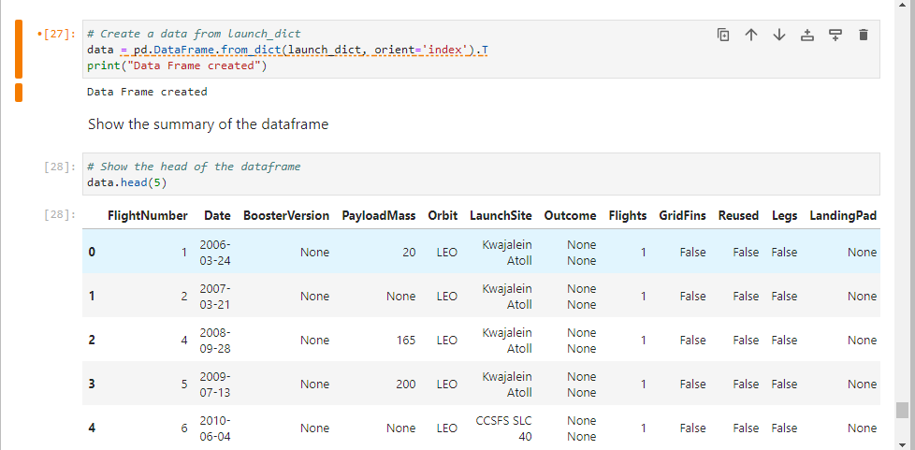
Data Collection – SpaceX API
After successful retrieval of the data and placing then into a dictionary , we created a panda data frame .
The screenshot shows the sample of data frame generated.

Slide 13
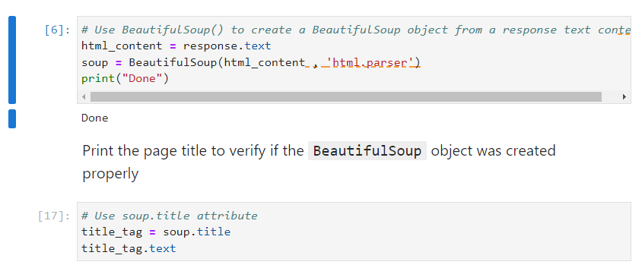
Data Collection - Scraping
Request the Falcon9 Launch Wiki page from its URL
Create a BeautifulSoup object from the HTML response.
GIT Hub Link : https://github.com/Nakul-Pant-DS/IBM-Data-Science-Capstone-Project/blob/main/jupyter-labs-webscraping.ipynb

Slide 14
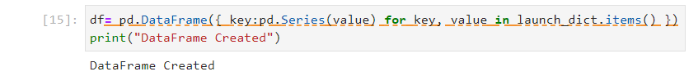
Data Collection - Scraping
Creating a data frame from the scrapped data
Finally, exporting the data to a csv file .

Slide 15
Data Wrangling
Some of the attributes that were scrapped were: Flight Number, Date, Booster version, Payload mass Orbit, Launch Site, Outcome, Grid Fins, Legs, Landing pad, Block, Reused count, Serial, Longitude and latitude of launch.
Removing Null values and replacing them with the MEAN.
Calculate the number of launches on each site .
Calculate the number and occurrence of each orbit
Create a landing outcome label from Outcome column.
GIT Hub Link : https://github.com/Nakul-Pant-DS/IBM-Data-Science-Capstone-Project/blob/main/labs-jupyter-spacex-Data%20wrangling.ipynb

Slide 16
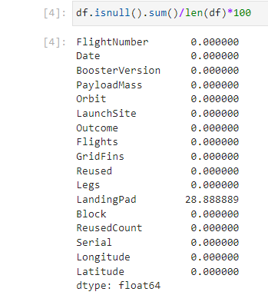
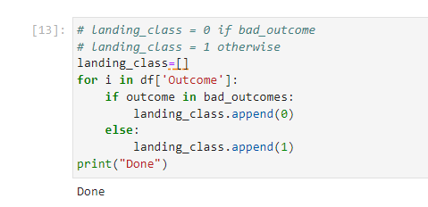
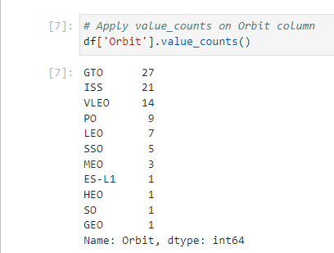
Data Wrangling

Slide 17
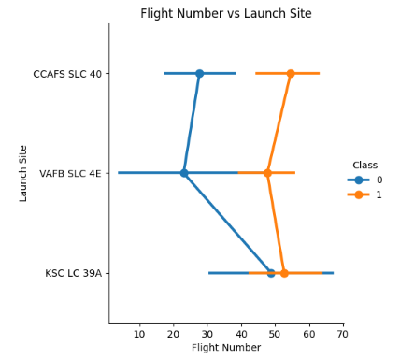
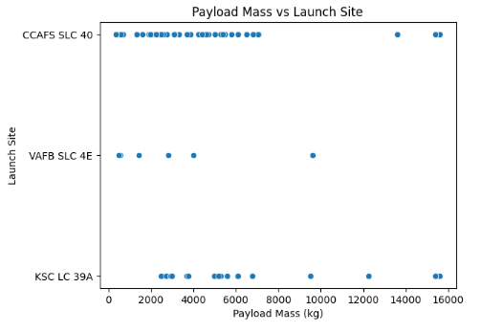
EDA with Data Visualization
We visualized the relationship between flight number and launch site, payload and launch site, success rate and orbit, number of flights and orbit, payload mass and orbit, and launch success yearly trend.

Slide 18
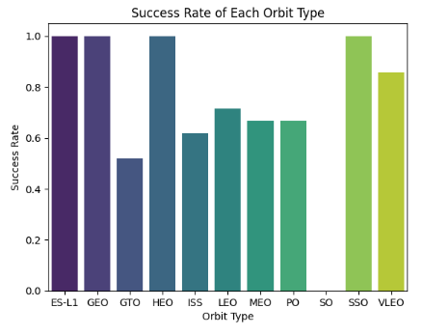
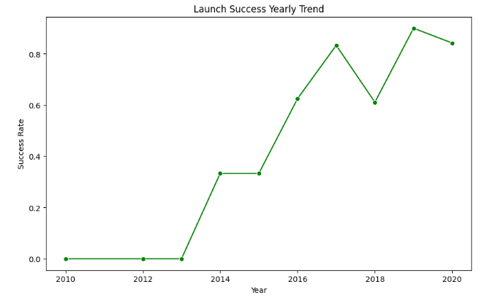
EDA with Data Visualization
GitHub Link : https://github.com/Nakul-Pant-DS/IBM-Data-Science-Capstone-Project/blob/main/jupyter-labs-eda-dataviz.ipynb.jupyterlite.ipynb

Slide 19
EDA with SQL
Following SQL queries performed in the data frame :
Display the names of the unique launch sites in the space mission.
Display 5 records where launch sites begin with the string 'CCA'
Display the total payload mass carried by boosters launched by NASA (CRS)
Display average payload mass carried by booster version F9 v1.1
List the date when the first successful landing outcome in ground pad was achieved.
List the names of the boosters which have success in drone ship and have payload mass greater than 4000 but less than 6000
List the total number of successful and failure mission outcomes
List the names of the booster versions which have carried the maximum payload mass.
List the records which will display the month names, failure landing outcomes in drone ship booster versions, launch site for the months in year 2015.
Rank the count of landing outcomes (such as Failure (drone ship) or Success (ground pad)) between the date 2010-06-04 and 2017-03-20, in descending order.
GIT Hub Link:
https://github.com/Nakul-Pant-DS/IBM-Data-Science-Capstone-Project/blob/main/jupyter-labs-eda-sql-coursera_sqllite.ipynb

Slide 20
Build an Interactive Map with Folium
We marked all launch sites, and added map objects such as markers, circles, lines to mark the success or failure of launches for each site on the folium map.
We assigned the feature launch outcomes (failure or success) to class 0 and 1.i.e., 0 for failure, and 1 for success.
Using the color-labeled marker clusters, we identified which launch sites have relatively high success rate.
We calculated the distances between the launch site and its proximities like railways, highways, and cities.
These markers were used to get a better visualization and understanding of the data through geography.
GitHub Link : https://github.com/Nakul-Pant-DS/IBM-Data-Science-Capstone- Project/blob/main/lab_jupyter_launch_site_location.jupyterlite.ipynb

Slide 21
Build a Dashboard with Plotly Dash
We built an interactive dashboard with Plotly dash.
We plotted pie charts showing the total launches by a certain sites.
We plotted scatter graph showing the relationship with Outcome and Payload Mass (Kg) for the different booster version.
GitHub Link: https://github.com/Nakul-Pant-DS/IBM-Data-Science-Capstone-Project/blob/main/spacex_dash_app.py

Slide 22
Predictive Analysis (Classification)
We split the dataset into training and testing set.
We built different machine learning models and tuned different hyperparameters using GridSearchCV.
We used accuracy as the metric for our model, and improved the model using feature engineering and hyperparameter tuning.
We found the best performing classification model.
GIT Hub Link : https://github.com/Nakul-Pant-DS/IBM-Data-Science-Capstone-Project/blob/main/SpaceX_Machine_Learning_Prediction_Part_5.jupyterlite.ipynb

Slide 23
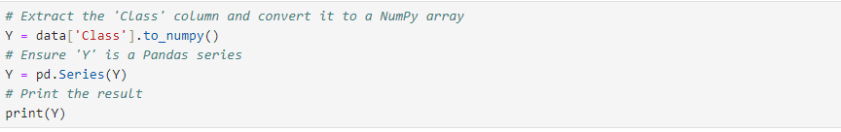
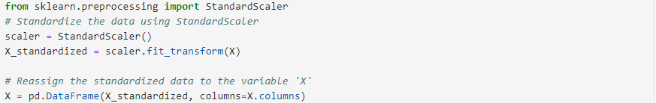
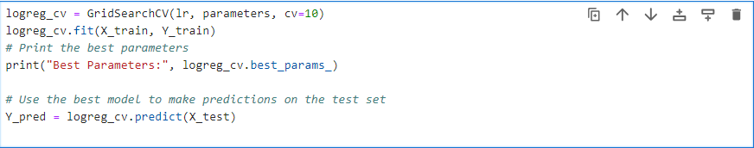
Predictive Analysis (Classification)

Slide 24
Results
Exploratory data analysis results : The results were shows with screenshots from lab.
Interactive analytics demo in screenshots : This include SQL query results as performed in lab.
Predictive analysis results : This include model score and confusion matrix.

Slide 25


Section 2 : Insights Drawn from EDA

Slide 26
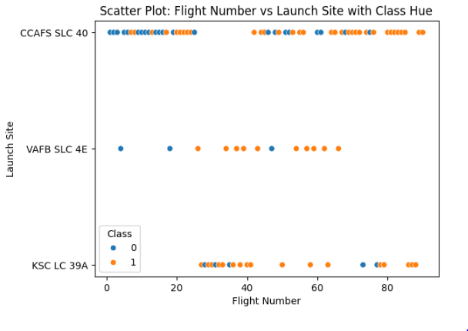
Flight Number vs. Launch Site
Scatter plot of Flight Number vs. Launch Site
From the scatter plot of Flight Number vs. Launch Site we see that greater the number of flights at a launch site, greater is the success rate at the launch site.

Slide 27
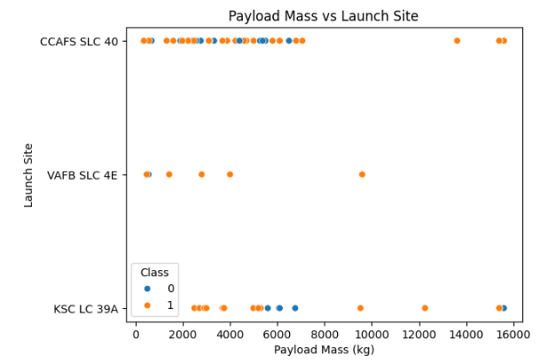
Payload vs. Launch Site
We observed that for Launch Site CCAFS SLC 40 and VAFB SLC 4E there is a linear relationship between payload mass i.e. as the payload mass increases the rate of successful launch also increases but for launch site KSC LC 39A there is no such relation with payload mass.

Slide 28
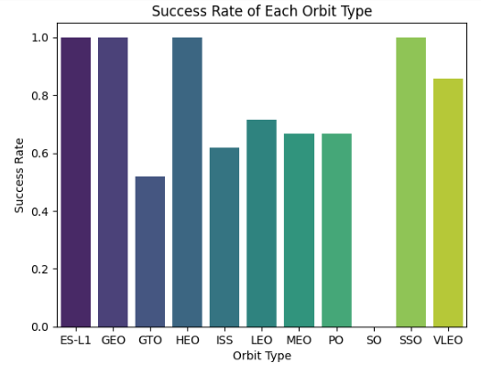
Success Rate vs. Orbit Type

Slide 29
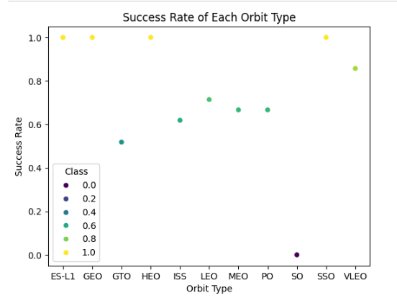
Success Rate vs. Orbit Type
We observe that only 4 orbit type achieved the Success:
ES-L1
GEO
HEO
SSO

Slide 30
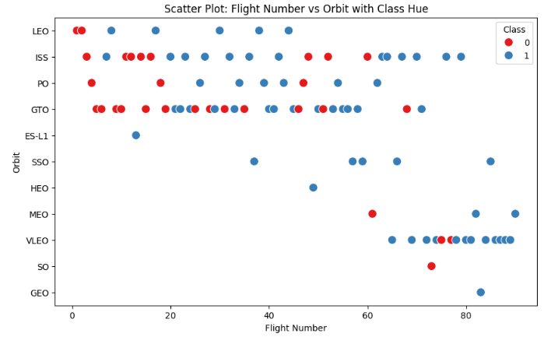
Flight Number vs. Orbit Type
We can clearly see that in the LEO orbit the Success appears related to the number of flights; on the other hand, there seems to be no relationship between flight number when in GTO orbit.

Slide 31
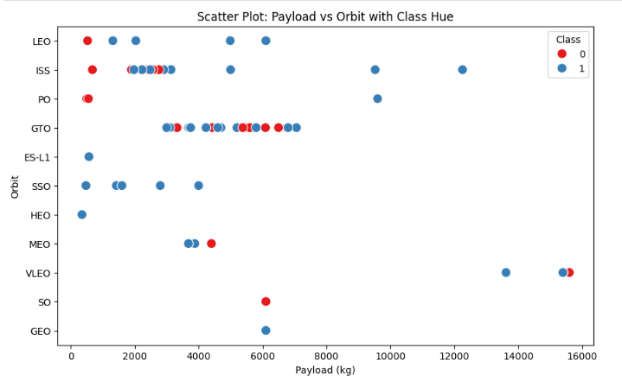
Payload vs. Orbit Type
With heavy payloads the successful landing or positive landing rate are more for Polar, LEO and ISS.
However for GTO we cannot distinguish this well as both positive landing rate and negative landing(unsuccessful mission) are both there here.

Slide 32
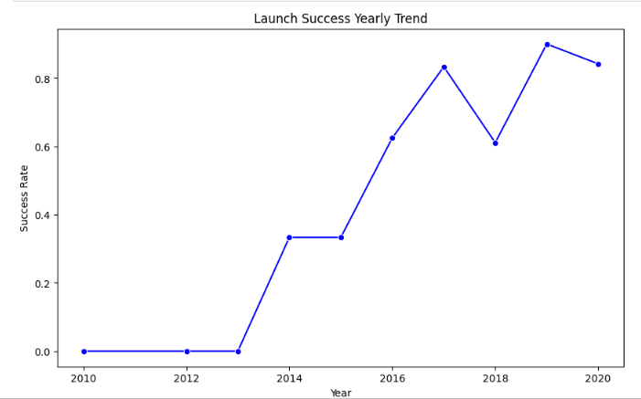
Launch Success Yearly Trend
We can observe that the success rate since 2013 kept increasing till 2020

Slide 33
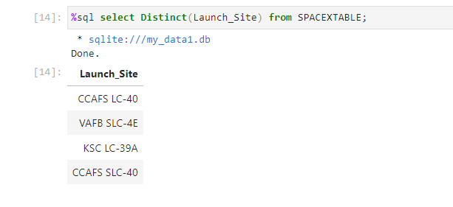
All Launch Site Names
Here we an see that there are 4 unique launch sites :
CCAFS LX-40
VAFB SLC- 4E
KSC LC- 39A
CCAFS SLC-40
We used the DISTINCT keyword to find all unique launch sites.

Slide 34
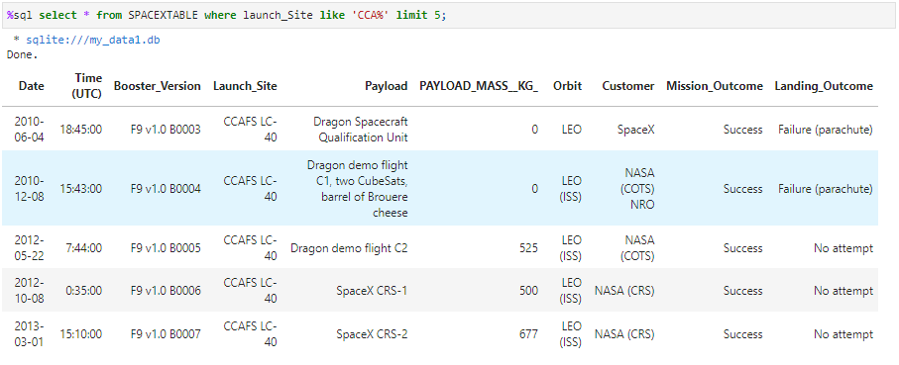
Launch Site Names Begin with 'CCA'
The keyword LIKE is used to specify that the launch site name begins with CCA.
The limit keyword is used to query only 5 records.

Slide 35
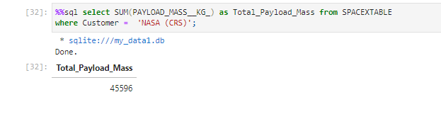
Total Payload Mass
The total payload mass for customer NASA (CSR) is 45,596 kg.
The function SUM is used to obtain the sum of payload mass.
The WHERE clause is used to specify that the customer should be NASA (CRS).

Slide 36
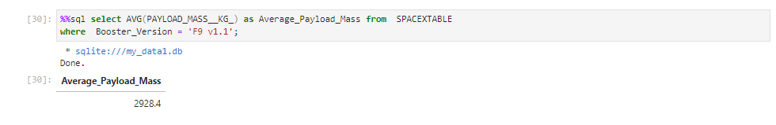
Average Payload Mass by F9 v1.1
The average payload mass for rockets with booster version F9 v1.1 is 2928.4 kg.
The function AVG is used to calculate the average of payload mass.
The WHERE clause is used to specify that the booster version should be F9 v1.1

Slide 37
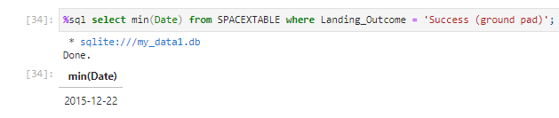
First Successful Ground Landing Date
The first successful ground landing occurred on 22 December 2015.
The function MIN is used to find the earliest date.
The WHERE clause is used to specify that the landing outcome is a successful ground pad landing.

Slide 38
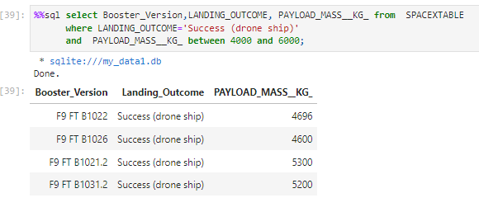
Successful Drone Ship Landing with Payload between
4000 and 6000
The names of boosters which have successfully landed on drone ship and had payload mass greater than 4000 but less than 6000 – F9 FT B1022, F9 FT B1026, F9 FT B1021.2, F9 FT B1031.
The WHERE clause specifies that the landing was a success drone ship landing.
The AND clause adds another condition that the payload mass is between 4000 and 600.

Slide 39
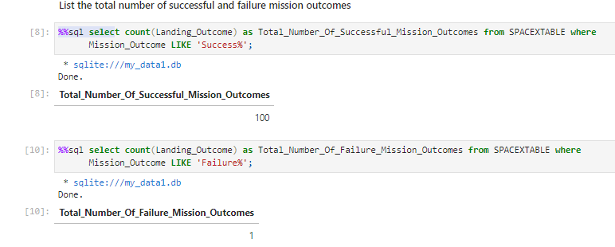
Total Number of Successful and Failure Mission Outcomes
Total Number of Successful Mission Outcomes –100
Total Number of Failure Mission Outcomes – 1.
The COUNT function gives the number of landings.
The LIKE clause is used to specify that the outcome is a success or a failure.

Slide 40
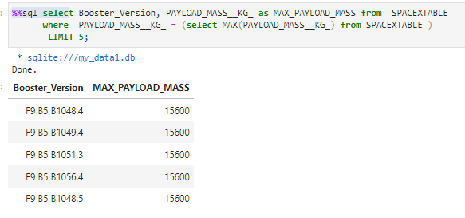
Boosters Carried Maximum Payload
These are the TOP 5 Booster Versions with Max Payload Mass:
F9 B5 B1048.4
F9 B4 B10494
F9 B5 B1056.4
F9 B5 B1056.4
F9 B5 B1048.5

Slide 41
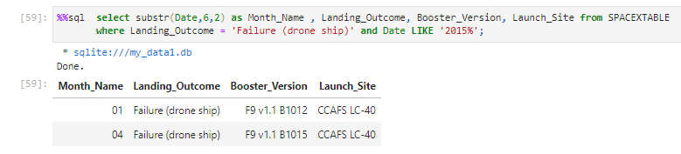
2015 Launch Records
The SUBSTR function selects the year out of the date.
The WHERE clause specifies that the date should be 2015 and the landing outcome should be a drone ship failure.

Slide 42
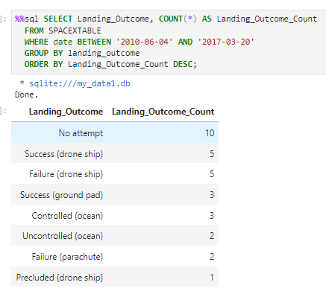
Rank Landing Outcomes Between
2010-06-04 and 2017-03-20
The result shows the landing outcome with “no attempt” has the maximum count. This was too obvious.
Where as those with Precluded(drone ship) has the minimum count.
Otherwise there is a close count between other Landing outcome types.

Slide 43


Section 3 : Proximity Analysis

Slide 44
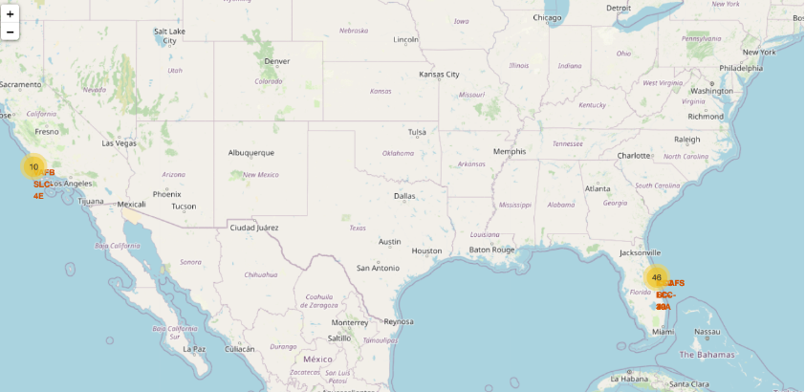
SPACE X : Launch Sites Map
VAFB SLC-4E on California Coast
Rest all Sites in Florida Coast

Slide 45
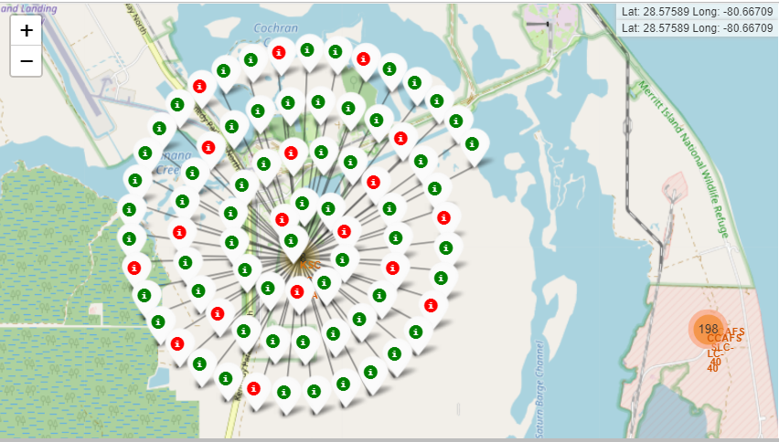
Success/Failures At Specific Launch Site
Red Marker : Failure
Green Marker: Success

Slide 46
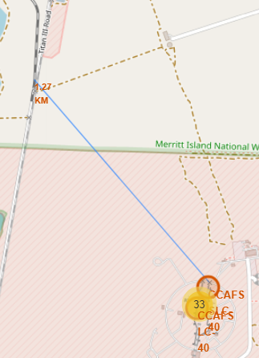
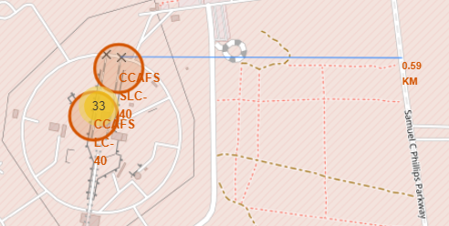
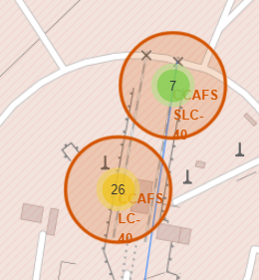
Infrastructure Near Launch Sites
Proximity To Highway
Proximity to Railway
2 Sites Keeping Safe Distance

Slide 47


Section 4 : Dashboard

Slide 48
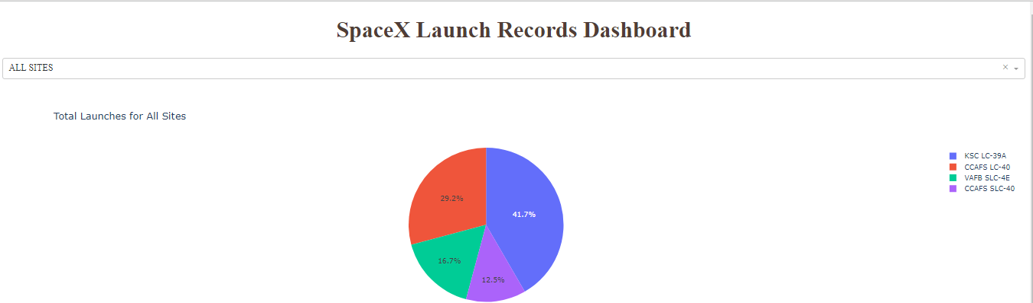
Total Success Launches By All Sites
Launch Site KSC LC-39A
has the most successful launch.

Slide 49
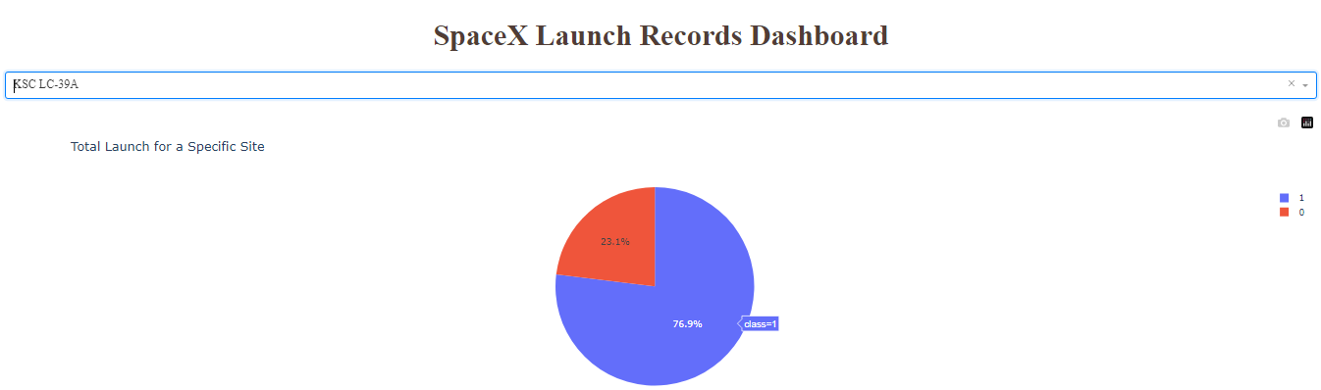
Launch Site With Highest Launch Success Ratio
We see that the Launch site KSC L-39A has a success rate of 75.9%.

Slide 50
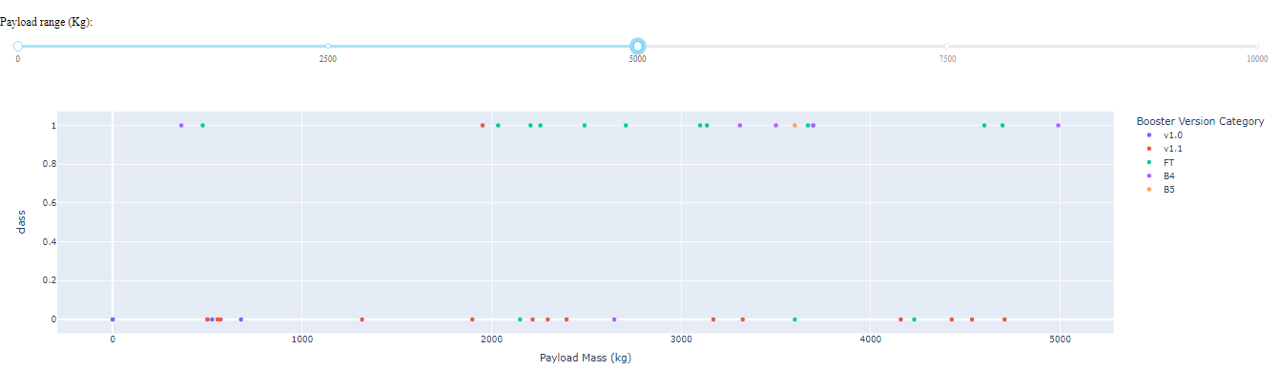
Launch Outcome of Payloads < 5000

Slide 51
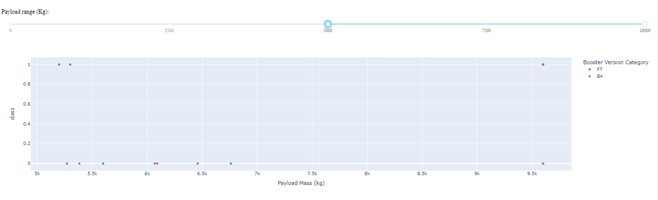
Launch Outcome of PayLoad Between 5000-10,000

Slide 52


Predictive Analysis (Classification)

Slide 53
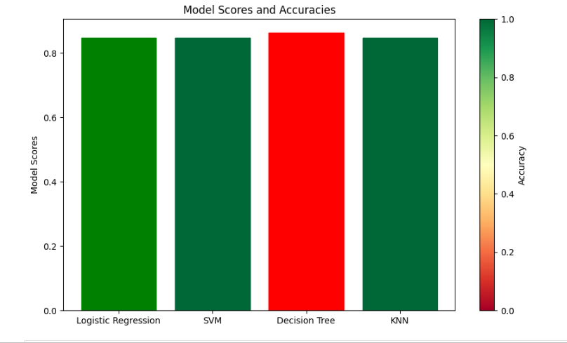
Classification Accuracy
The bar chart show model with maximum accuracy in red while with low accuracy in green.
The Decision Tree gives the maximum accuracy.

Slide 54
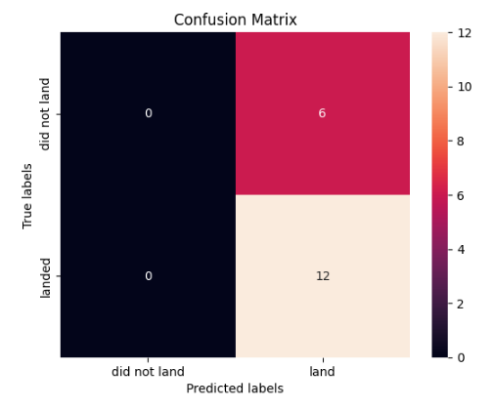
Confusion Matrix
The confusion matrix for the Decision Tree Classifier shows that the classifiers has done a good job in predicting12 successful landing while the classifier shows 6 landings that were not supposed to land but it predicted otherwise .

Slide 55
Conclusions
The greater the number of flights at a launch site, greater is the success rate at the launch site.
ES-L1, GEO, HEO, and SSO orbits have the highest success rate.
For heavier payloads, success rate increases for LEO, ISS and Polar orbits.
Launch success rate increased from 2013 to 2020 with minor fluctuations throughout the period.
Launch Site KDC LC-39 A has the Greatest Launch Success Rate.
The Decision Tree Classifier is the best machine learning algorithm to predict SpaceX Falcon 9 rocket’s first stage will land successfully.

Slide 56
Appendix
Data Dictionary: The following features were used to build the model: BoosterVersion|PayloadMass|Orbit|LaunchSite|Outcome|Flights|GridFins|Reused|Legs|LandingPad|Block|ReusedCount|Serial|Longitude|Latitude|Class
References and Citations: Getting Started with Data Science: Making Sense of Data with Analytics by Murtaza
Haider
Supplementary Analyses:
We observed that the accuracy of all the models are almost similar but still the Decision Tree Algorithm gives a the maximum model score of ~ 87% this is because Decision trees are inherently non-linear models and can capture non-linear relationships in the data more effectively than linear models like logistic regression.

Slide 57


Thank You!!!

